Slide 1
Stochastic Modeling
Decisions Under Uncertainty

Slide 2
What You Will Learn
In general, you will learn a framework to make decisions under uncertainty. Specifically,
Learn how to use the Expected Value and Decisions Trees to evaluate different alternatives.
Learn how to apply Bayes’ Theorem to correctly update the probabilities in your model.
Learn how to model different Risk Profiles.

Slide 3
Expected Value

Slide 4
Expected Value
When we think about decisions, we face uncertainty.
Ex: weather, traffic, restaurant quality, our mood, etc.
Our objective is to develop a model where decisions interact with probabilities and outcomes. This framework will help us make better decisions on average.

Slide 5
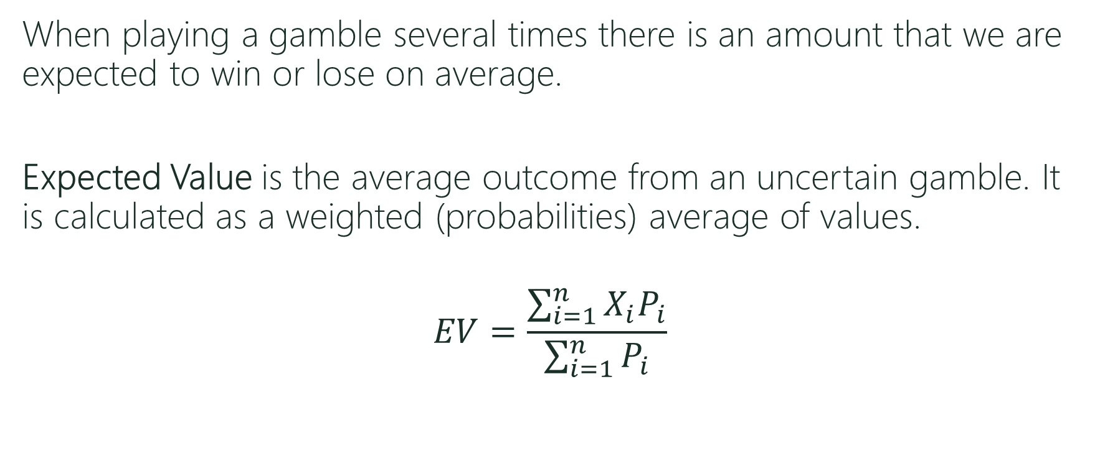
Expected Value
When playing a gamble several times there is an amount that we are expected to win or lose on average.
Expected Value is the average outcome from an uncertain gamble. It is calculated as a weighted (probabilities) average of values.
$$EV=\frac{\sum_{i=1}^{n}{X_{i}P_{i}}}{\sum_{i=1}^{n}{P_{i}}}$$
Values
Probabilities

Slide 6


Expected Value
Player A wins $1 from B when not matching:
Player A -> Heads Player B -> Tails
Player A -> Tails Player B -> Heads
Player B wins $1 from A when matching:
Player A -> Heads Player B -> Heads
Player A -> Tails Player B -> Tails

Slide 7

Expected Value
Player A
EV = $1*P(Not Match)-$1*P(Match) $EV=\frac{\sum_{i=1}^{n}{X_{i}P_{i}}}{\sum_{i=1}^{n}{P_{i}}}$
EV = $1*1/2-$1*1/2
EV = 0
Player B
EV = $1*P(Match)-$1*P(Not Match)
EV = $1*1/2-$1*1/2
EV = 0

Slide 8
Expected Value
Player A wins $10 from B when not matching:
Player B wins $1 from A when matching:
What is Player A’s EV?
What is Player B’s EV?
Would Player A want to play the game? Would player B want to play the game?
The EV allows us to rank decisions that involve uncertainty.

Slide 9
Decision Trees

Slide 10
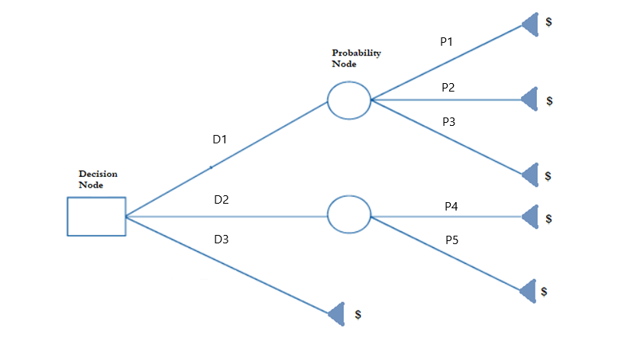
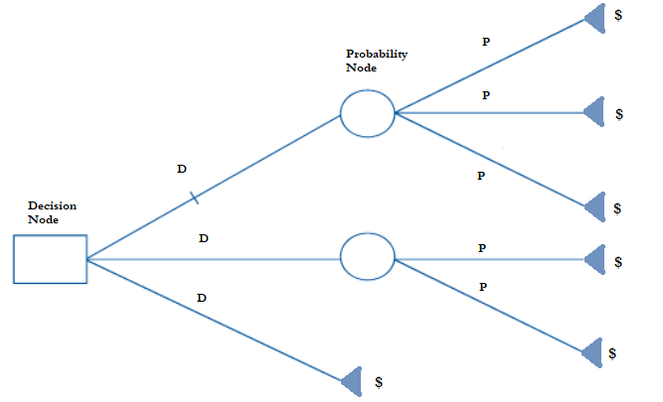
Decisions Trees
D = Decision
P = Probability
$ = Monetary Value

Slide 11
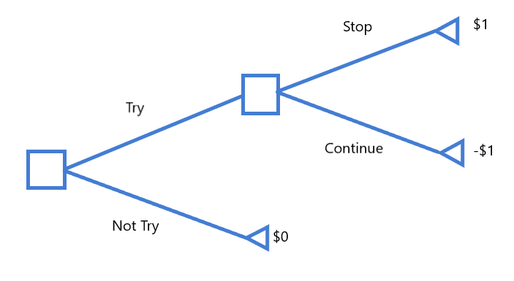
Decision Trees
To try or not to try…

Slide 12
Solving Decision Trees
To solve decision trees we use backward induction:
Start at the end of the tree (right).
Choose the branch that leads to the highest payoff for each of the last decision nodes.
Repeat procedure while moving backwards to the initial node.

Slide 13
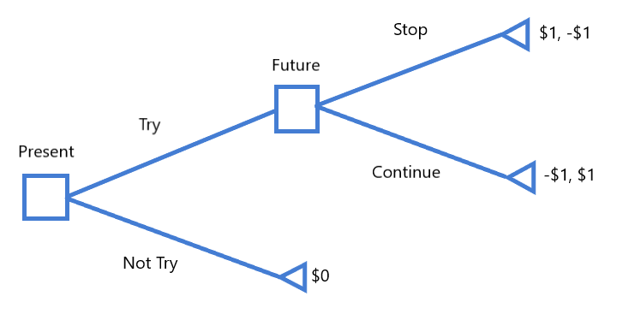
Decision Trees (Interactive)
To try or not to try…

Slide 14
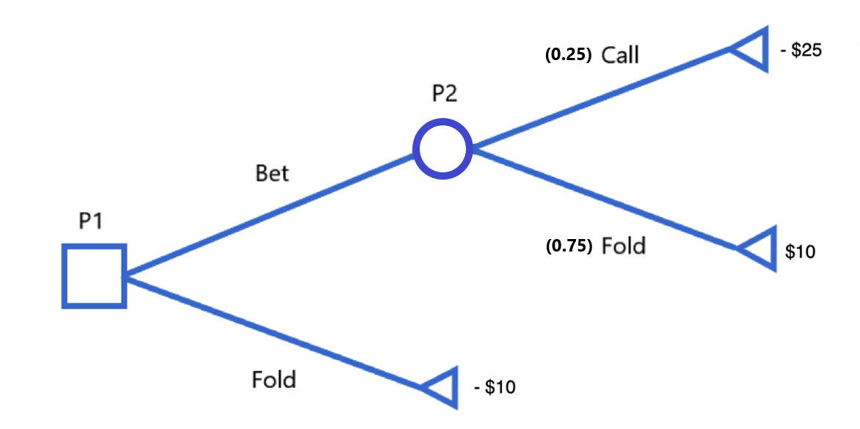
Decision Trees (Uncertainty)
Bluffing in Poker with a Losing Hand…

Slide 15
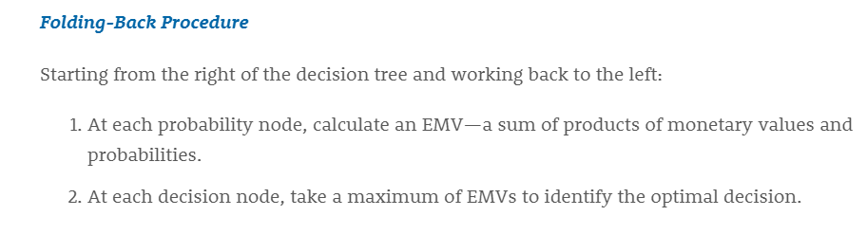
Decision Trees (Uncertainty)
To solve decision trees with uncertainty use the folding-back procedure:

Slide 16
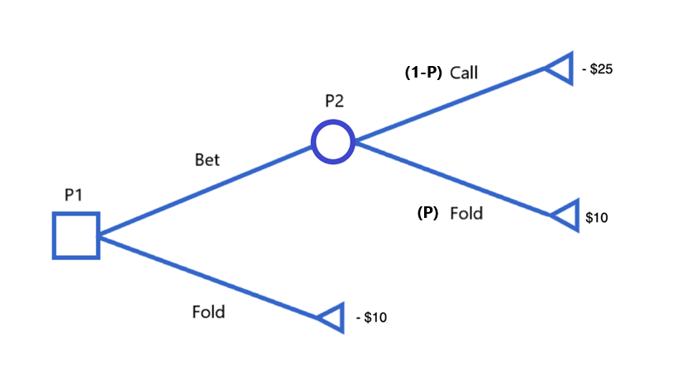
Decision Trees (Uncertainty)
When to bluff with a Losing Hand?

Slide 17
Assigning Probabilities
Classical Method: The classical method of assigning probabilities is appropriate when all the experimental outcomes are equally likely. If n experimental outcomes are possible, a probability of 1/n is assigned to each experimental outcome.
Subjective: The subjective method of assigning probabilities is most appropriate when one cannot realistically assume that the experimental outcomes are equally likely and when little relevant data are available.
Empirical: The empirical method of assigning probabilities is appropriate when data are available to estimate the proportion of the time the experimental outcome will occur if the experiment is repeated a large number of times.

Slide 18
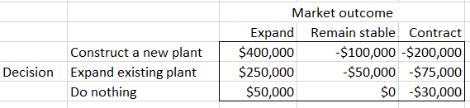
Decision Trees (Example)
Carlisle Tire and Rubber, Inc., is considering expanding production to meet potential increases in the demand for one of its tire products. Carlisle’s alternatives are to construct a new plant, expand the existing plant, or do nothing in the short run. The market for this tire product may expand, remain stable, or contract. Carlisle’s marketing department estimates the probabilities of these market outcomes to be 0.35, 0.35, and 0.30, respectively. What would you recommend Carlisle to do to meet demand?

Slide 19
Decision Trees (Uncertainty)
We can solve this problem several ways:
Drawing a decision tree by hand and using the folding-back procedure
Using an Excel spreadsheet

Slide 20
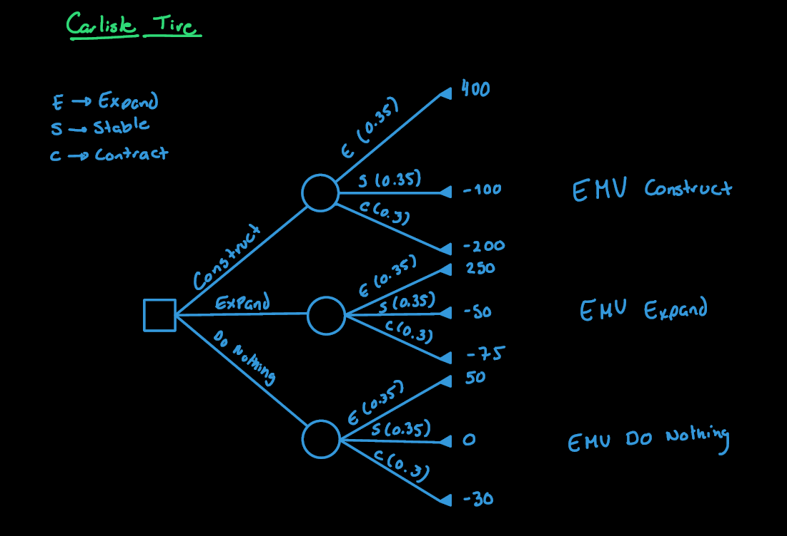

Slide 21
Decision Trees (Example 2)
The Newtown Art Gallery has a valuable painting that it wishes to sell at auction. There will be three bidders for the painting. The first bidder will bid on Monday, the second on Tuesday, and the third on Wednesday. Each bid must be accepted or rejected that same day. Newton Art Gallery can decide to not sell at the auction and instead accept an offer of $900,000. What should NAG do?
 | Probabilities
Amount of Bid | Bidder 1 | Bidder 2 | Bidder 3
$1,000,000.00 | 0 | 0 | 0.7
$2,000,000.00 | 0.5 | 0.9 | 0
$3,000,000.00 | 0.5 | 0 | 0
$4,000,000.00 | 0 | 0.1 | 0.3

Slide 22
Decision Trees (Example 3)
A local energy provider offers a landowner $180,000 for the exploration rights to natural gas on a certain site and the option for future development. This option, if exercised, is worth an additional $1,800,000 to the landowner, but this will occur only if natural gas is discovered during the exploration phase. The landowner, believing that the energy company’s interest in the site is a good indication that gas is present, is tempted to develop the field herself. To do so, she must contract with local experts in natural gas exploration and development. The initial cost for such a contract is $300,000, which is lost forever if no gas is found on the site. If gas is discovered, however, the expectation is that the land will yield revenue of $6,000,000. The probability of finding gas on this site is 60%.
Should the landowner make a deal with the energy provider?
How much should the energy provider pay the landowner to convince her to give them the right for exploration?
Is it better to increase the offer to the landowner via the offer or by sharing more of the profits?

Slide 23
Laws of Probability

Slide 24
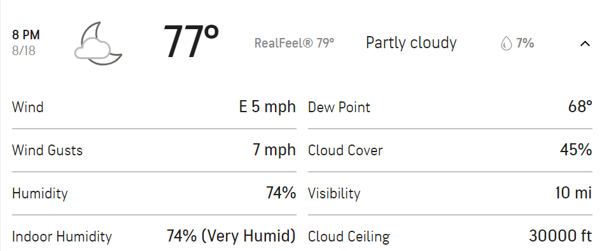
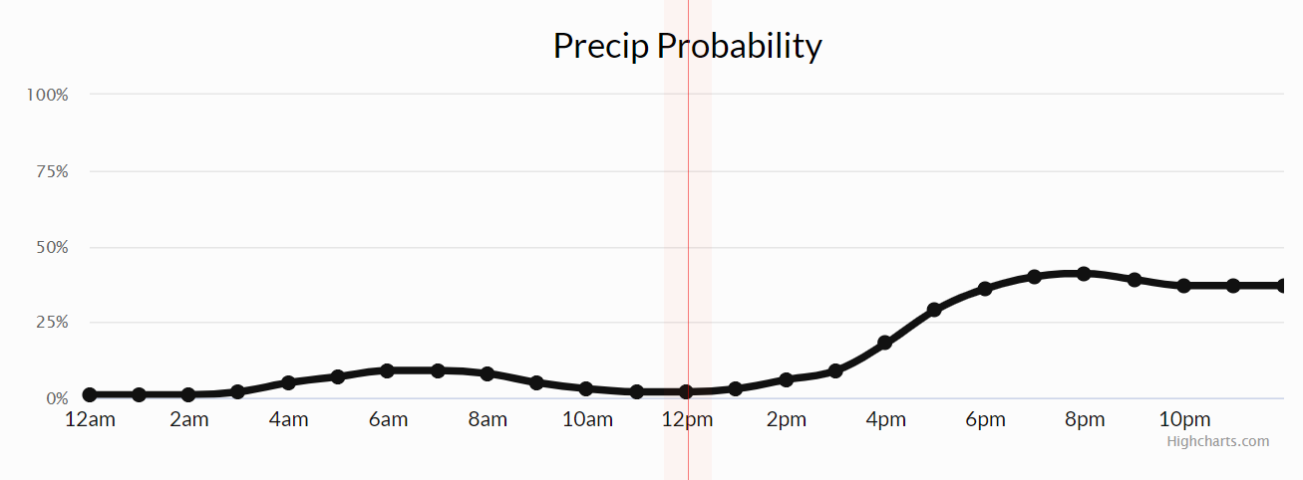
Probability Review
First Law of Probability: The probability of an event is a number between zero and one. 0 -> Certain to not occur. 1 -> Certain to occur.

Slide 25
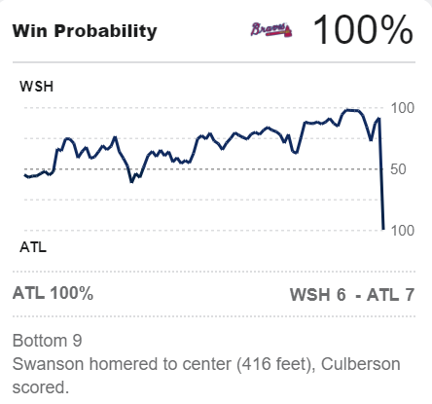
Probability Review
2nd: 3-2
6th: 5-3
New information affects probabilities! Events and Time.

Slide 26
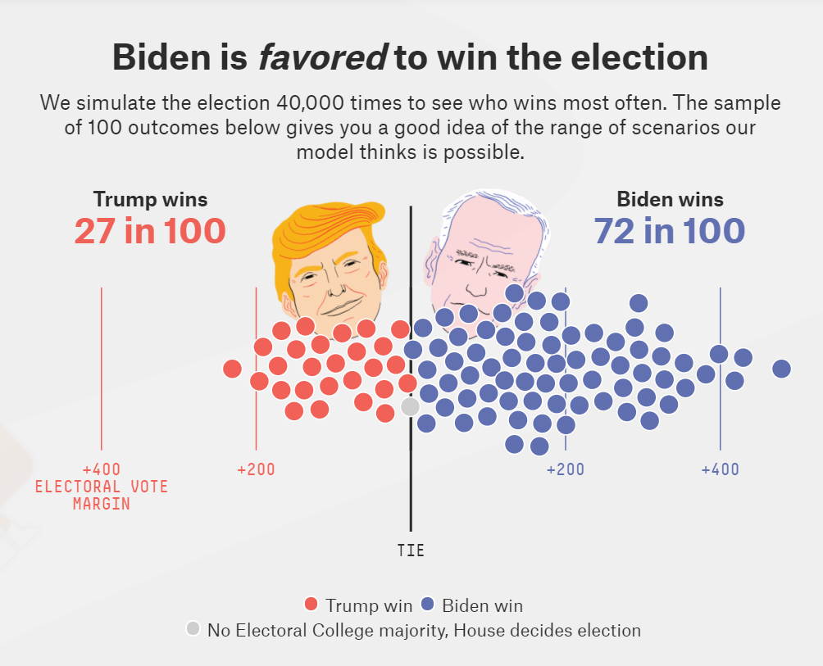
Probability Review
When information is limited, we can use simulation to approximate probabilities!
Notes:
https://projects.fivethirtyeight.com/2020-election-forecast/

Slide 27
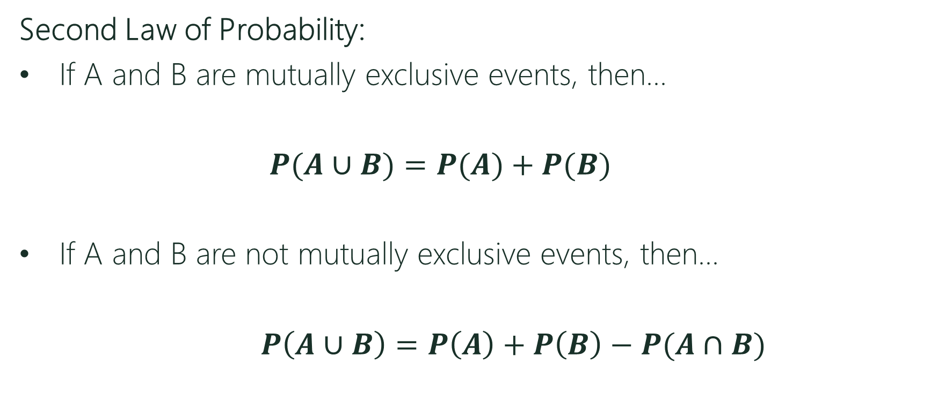
Probability Review
Second Law of Probability:
If A and B are mutually exclusive events, then…
$P(A∪B)=P(A)+P(B)$
If A and B are not mutually exclusive events, then…
$P\left(A∪B\right)=P\left(A\right)+P\left(B\right)−P(A∩B)$
Union

Slide 28
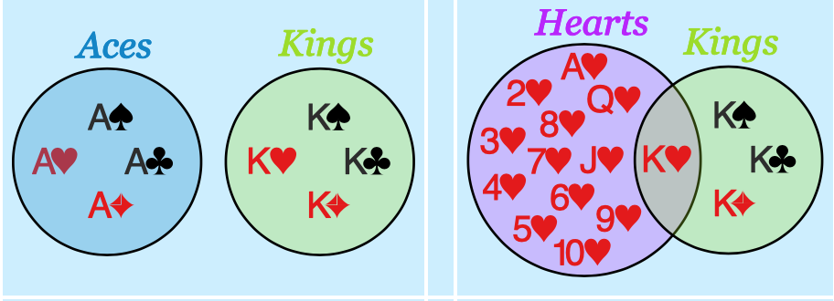
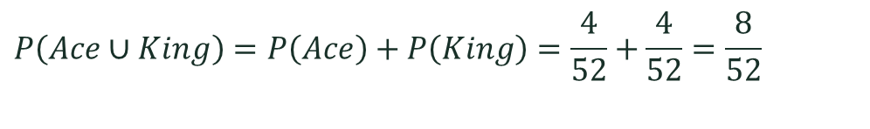
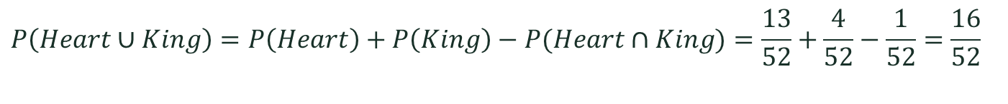
Probability Review
A standard deck of card has 52 cards.
OR
Mutually Exclusive
Not Mutually Exclusive
$$P\left(Ace∪King\right)=P\left(Ace\right)+P\left(King\right)=\frac{4}{52}+\frac{4}{52}=\frac{8}{52}$$
$$P\left(Heart∪King\right)=P\left(Heart\right)+P\left(King\right)−P(Heart∩King)=\frac{13}{52}+\frac{4}{52}−\frac{1}{52}=\frac{16}{52}$$

Slide 29




Probability Review
Third Law of Probability: For events A and B:
$$P\left(A|B\right)=\frac{P\left(A∩B\right)}{P\left(B\right)}$$
Intersection
Given
$$=\frac{8/100}{20/100}$$
A
B
10
8
12
$$P\left(A|B\right)=8/20$$
70
$$A∩B$$

Slide 30

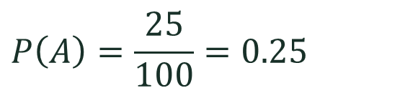
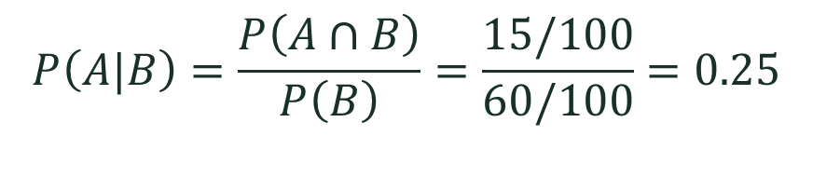

Probability Review
Fourth Law of Probability: If A and B are independent then
$$P(A|B)=P(A)$$
A
B
$$P\left(A|B\right)=\frac{P\left(A∩B\right)}{P\left(B\right)}=\frac{15/100}{60/100}=0.25$$
10
15
45
$$P\left(A\right)=\frac{25}{100}=0.25$$
30
$$A∩B$$

Slide 31
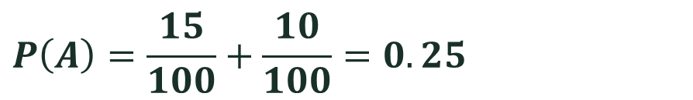





Probability Review
Law of Total Probability:
$P\left(A\right)=P\left(A|B\right)P\left(B\right)+P\left(A|B^{c}\right)P(B^{c})$
Complement
$$B$$
$$B^{c}$$
$$A$$
By using the third law…
$$P\left(A\right)=P\left(A∩B\right)+P(A∩B^{c})$$
$$P\left(A\right)=\frac{15}{100}+\frac{10}{100}=0.25$$
$$P\left(A∩B\right)$$
$$P(A∩B^{c})$$

Slide 32
Bayes’ Theorem

Slide 33
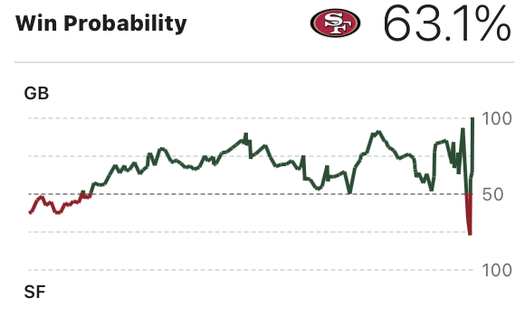



Bayes’ Theorem
How does new information affect our prior expectations?
Prior probabilities
Information observed
Posterior probabilities
Bayes’ Theorem
$$\frac{P\left(B|A\right)}{P(B)}$$
$$P(A)$$
$$=P\left(A|B\right)$$
Prior
Posterior
Informativeness
Notes:
Law of total probability in the denominator. Can be written as P(AnB)+P(AnB’) by using the law of total probability.
The prior is what you believed about A before having encountered a new and relevant piece of information B.
The quotient of the likelihood divided the marginal probability of the new piece of information indexes the informativeness of the new information for your beliefs about B
The posterior is what you believe (or ought to, if you are rational) about B after having encountered a new and relevant piece of information.

Slide 34

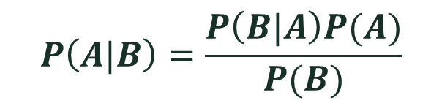
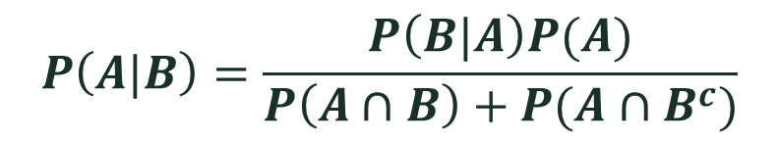
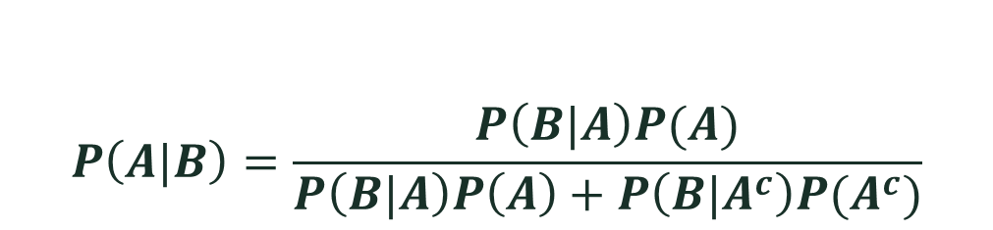
Bayes’ Theorem
EXPRESSIONS OF BAYES…
$$P\left(A|B\right)=\frac{P\left(B|A\right)P(A)}{P(B)}$$
$$P\left(A|B\right)=\frac{P\left(B|A\right)P(A)}{P\left(B|A\right)P\left(A\right)+P\left(B|A^{c}\right)P(A^{c})}$$
$$P\left(A|B\right)=\frac{P\left(B|A\right)P(A)}{P\left(A∩B\right)+P(A∩B^{c})}$$
...........

Slide 35
Bayes’ Theorem (Example)
Probability of having a kind of cancer P(C)=1%
Probability of testing positive when not having cancer (NC)
P(+|NC)=10% False Positive (T1) P(-|NC)=90%
Probability of testing negative when having the disease (C)
P(-|C)=5% False Negative (T2) P(+|C)=95%
What is the probability of having the disease given that the test was positive?
P(C|+)=?

Slide 36






Bayes’ Theorem
P(C)=1% P(+|NC)=10% P(-|NC)=90% P(-|C)=5% P(+|C)=95%
$$\frac{P\left(C\right)P(+∕C)}{P(+)}$$
$$P\left(C|+\right)=$$
Using Bayes’ Theorem…
Substituting…
$$0.01∗8.7558=8.75\%$$
$$P\left(+\right)=$$
Using the Law of Total Prob…
$$P\left(+|C\right)P\left(C\right)+P\left(+|NC\right)P(NC)$$
Substituting…
0.95*0.01$+0.1∗0.99=$
0.1085
Getting a positive test is relatively rare.

Slide 37
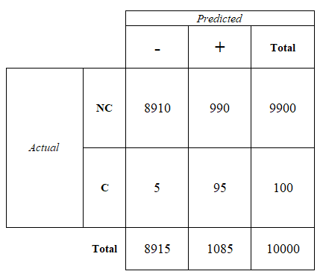
Bayes’ Theorem
Let’s assume a sample of 10,000…
Marginal P(C)=1% P(NC)=99% P(+)=10.85% P(-)=89.15% Conditional P(+|NC)=10% P(-|NC)=90% P(-|C)=5% P(+|C)=95% P(C|+)=8.75% P(NC|+)=91.25% P(C|-)=95% P(NC|-)=95%
Accuracy
90.05%
Precision
8.75%
Recall
95%
Specificity
90%
Type I
10%
Type II
5%
Notes:
It gives the hint on where the model/test went wrong
Specificity: (-|NC) /total

Slide 38




Bayes’ Theorem (Example)
Suppose you are tested to see if you have a rare disease. Assume that if you have the disease, your test will always come back positive, but if you do not have the disease, there is still a 0.001 chance that you will test positive. In reality, only 1 of 10,000 people have the disease. Your doctor calls and says that you have tested positive. He is sorry but there is a 99.9% (1−0.001) chance that you have the disease. Is he correct? What is the actual probability that you have the disease?
$$P(+|D)$$
$$P(+|ND)$$
$$P(D)$$
$$P(D|+)$$

Slide 39
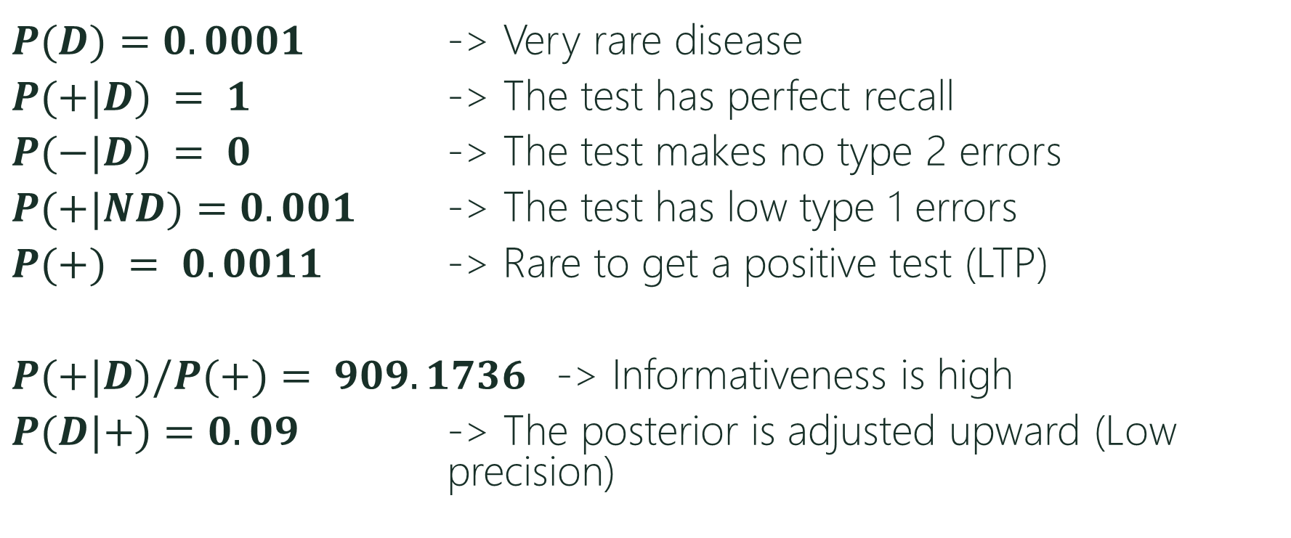
Bayes’ Theorem
$P(D)=0.0001$ -> Very rare disease
$P(+|D) = 1$ -> The test has perfect recall
$P(−|D) = 0$ -> The test makes no type 2 errors
$P(+|ND)=0.001$ -> The test has low type 1 errors
$P(+) = 0.0011$ -> Rare to get a positive test (LTP)
$P(+|D)/P(+)= 909.1736$ -> Informativeness is high
$P(D|+)=0.09$ -> The posterior is adjusted upward (Low precision)

Slide 40




Bayes’ Theorem (Example)
If you believe that 3% of graduate students are enrolled in computer science, and you also believe that the description of Arun is 4 times more likely for a graduate student in that field than in other fields, then Bayes’ rule says you must believe that the probability that Arun is a computer scientist to be…
$$P(CS|D)=P(CS)∗\frac{P\left(D | CS\right)}{P\left(D\right)}$$
$$P(CS)=3\%$$
$$=11.009\%$$
Using Bayes’ Theorem…
$$P(D|CS)=4∗P(D|NCS)$$
Using Law of Total Probability…
$$P\left(D\right)=P\left(D | CS\right)P\left(CS\right)+P\left(D | NCS\right)P(NCS)$$
$$P\left(D\right)=27.25\%P\left(D | CS\right)$$

Slide 41



Example of Updating Probabilities in Decision Trees
$$P\left(S\right)=30\%$$
$$P\left(+|W\right)=10\%$$
$$P\left(−|S\right)=20\%$$
Caroline Janes is the marketing manager for a consumer products company that is considering whether to produce a new automatic dishwashing detergent called “Suds-Away.” The market for Suds Away will either be weak or it will be strong. If the market is strong, the company will make $18 million on Suds-Away, but if the market is weak the company will lose $8 million. Based on a combination of experience and intuition, Caroline has estimated that there is a 30% chance that the market for Suds-Away will be strong. Prior to deciding whether or not to produce Suds-Away, Caroline can conduct a nationwide market survey test of Suds-Away. The cost of the market survey would be $2.4 million. Such a market survey is not perfect. Past results indicate that if the market is weak, there is a 10% chance that the test will be positive. Also, if the market is strong, there is a 20% chance that the test will be negative. What should Caroline do?

Slide 42
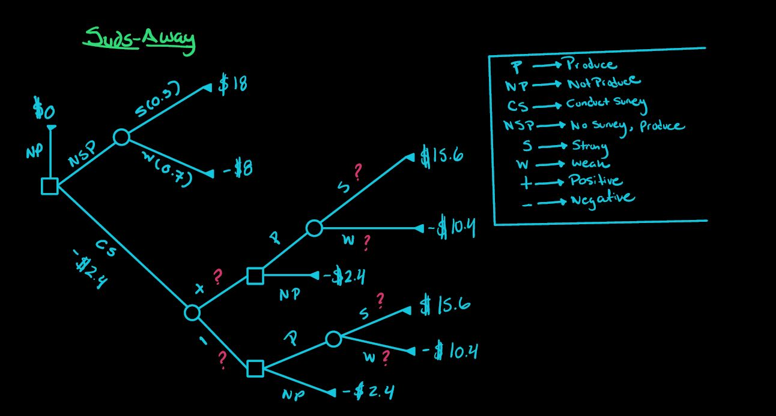



$$P\left(S\right)=30\%$$
$$P\left(+|W\right)=10\%$$
$$P\left(−|S\right)=20\%$$

Slide 43
The Value of Information
The Expected Value of Information (EVI):
The increase in the expected value that the information generates (i.e. is what we gain by getting the information for free).
$$EVI=EMV with \left(free\right) information −EMV without information$$

Slide 44
The Value of Information
The Expected Value of Free and Perfect Information:
The increase in the expected value that the perfect information generates (i.e. is what we gain by getting the free and accurate information).
$$EVPI=EMV with \left(free\right) perfect information −EMV without information$$

